Slide 1
Advance programming
First lecture: Review
Baida’a Lala’a

Slide 2
Course topics
We will study in this course:
Design patterns
Web services
XML
Remoting objects
Event pattern
Client server programming

Slide 3
References of This Lecture
Starting Out with Python-Third edition--Tony Gaddis
Introduction to Python Programming -Gowrishankar S. Veena A.

Slide 4
Type of Programming
Procedural programming is a method of writing software. It is a programming practice centered on the procedures or actions that take place in a program.
Object-oriented programming is centered on objects. Objects are created from abstract data types that encapsulate data and functions together
The object is, conceptually, a self-contained unit that consists of data attributes and methods that operate on the data attributes.
OOP is a way to organize and conceptualize a program as a set of interacting objects.

Slide 5
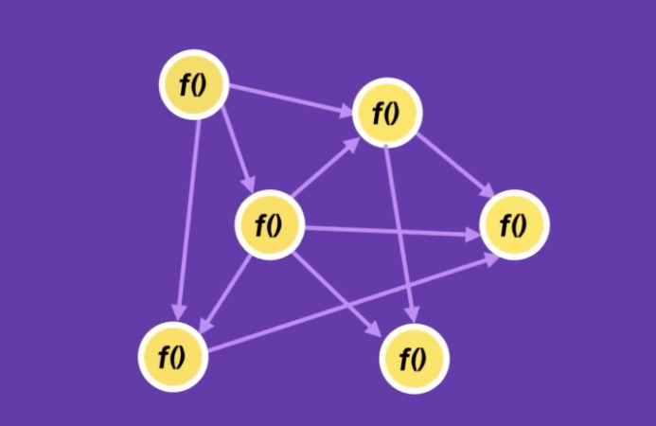
Procedural programming

Slide 6
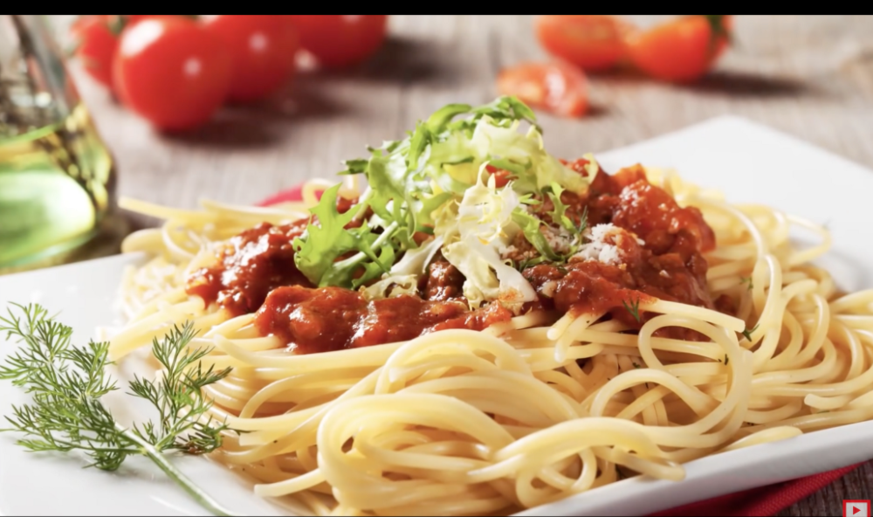
Procedural programming
In procedural programming, due to the fact that functions are linked together, the program might even break with just one change. This is what developers call spaghetti code.

Slide 7
Encapsulation and Data hiding
OOP addresses the problem of code and data separation through encapsulation and data hiding.
Encapsulation refers to the combining of data and code into a single object.
Data hiding refers to an object’s ability to hide its data attributes from code that is outside the object. Only the object’s methods may directly access and make changes to the object’s data attributes. An object typically hides its data, but allows outside code to access its methods. As shown in Figure 10-2, the object’s methods provide programming statements outside the object
with indirect access to the object’s data attributes

Slide 8
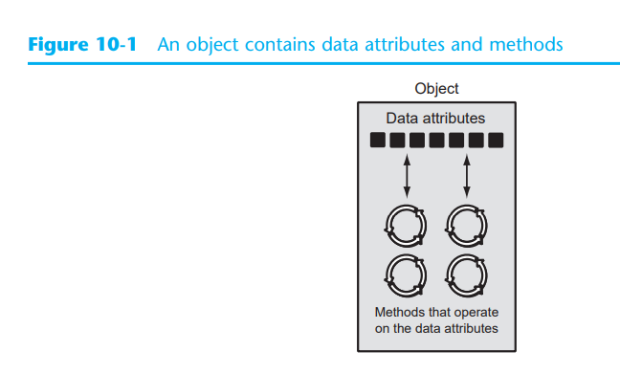

Slide 9
When an object’s data attributes are hidden from outside code, and access to the data attributes is restricted to the object’s methods, the data attributes are protected from accidental corruption. In addition, the code outside the object does not need to know about the format or internal structure of the object’s data. The code only needs to interact with the object’s methods. When a programmer changes the structure of an object’s internal data attributes, he or she also modifies the object’s methods so that they may properly operate on the data.
The way in which outside code interacts with the methods, however, does not change.

Slide 10
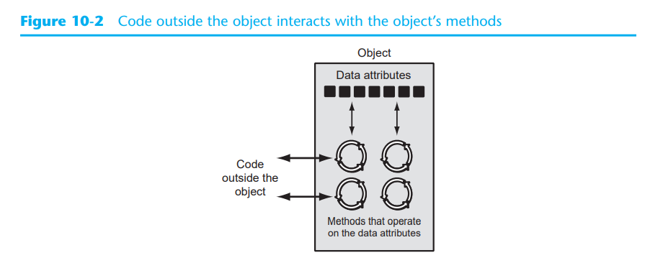

Slide 11
Object Reusability
In addition to solving the problems of code and data separation, the use of OOP has also been encouraged by the trend of object reusability. An object is not a stand-alone program, but is used by programs that need its services.

Slide 12
Example
Imagine that your alarm clock is actually a software object. If it were, it would have the following data attributes:
• current_second (a value in the range of 0–59)
• current_minute (a value in the range of 0–59)
• current_hour (a value in the range of 1–12)
• alarm_time (a valid hour and minute)
• alarm_is_set (True or False)

Slide 13
Every second the increment_current_second method executes. This changes the value of the current_second data attribute.
If the current_second data attribute is set to 59 when this method executes, the method is programmed to reset current_second to 0, and then cause the increment_current_minute method to execute. This method adds 1 to the current_minute data attribute, unless it is set to 59. In that case, it resets current_minute to 0 and causes the increment_current_hour method to execute. The increment_current_minute method compares the new time to the alarm_time.
If the two times match and the alarm is turned on, the sound_alarm method is executed.

Slide 14
As you can see, the data attributes are merely values that define the state that the alarm
clock is currently in. You, the user of the alarm clock object, cannot directly manipulate
these data attributes because they are private. To change a data attribute’s value, you
must use one of the object’s methods. The following are some of the alarm clock object’s
methods:
• set_time
• set_alarm_time
• set_alarm_on
• set_alarm_off

Slide 15
Each method manipulates one or more of the data attributes. For example, the set_time method allows you to set the alarm clock’s time. You activate the method by pressing a button on top of the clock. By using another button, you can activate the set_alarm_time method.
In addition, another button allows you to execute the set_alarm_on and set_alarm_off methods. Notice that all of these methods can be activated by you, who are outside the alarm clock. Methods that can be accessed by entities outside the object are known as public methods.

Slide 16
The alarm clock also has private methods, which are part of the object’s private, internal workings. External entities (such as you, the user of the alarm clock) do not have direct access to the alarm clock’s private methods. The object is designed to execute these methods automatically and hide the details from you. The following are the alarm clock object’s
private methods:
• increment_current_second
• increment_current_minute
• increment_current_hour
• sound_alarm

Slide 17
Checkpoint
10.1 What is an object?
10.2 What is encapsulation?
10.3 Why is an object’s internal data usually hidden from outside code?
10.4 What are public methods? What are private methods?

Slide 18
Concept: A class is code that specifies the data attributes and methods for a particular type of object.
Now, let’s discuss how objects are created in software.
Before an object can be created, it must be designed by a programmer. The programmer determines the data attributes and methods that are necessary and then creates a class.
Think of a class as a “blueprint” that objects may be created from. It serves a similar purpose as the blueprint for a house. The blueprint itself is not a house, but is a detailed description of a house. When we use the blueprint to build an actual house, we could say we are building an instance of the house described by the blueprint. If we so desire, we can build several identical houses from the same blueprint. Each house is a separate instance of the house described by the blueprint. This idea is illustrated in Figure 10-3.

Slide 19
A Class
Another way of thinking about the difference between a class and an object is to think of the difference between a cookie cutter and a cookie. While a cookie cutter itself is not a cookie, it describes a cookie. The cookie cutter can be used to make several cookies, as shown in Figure 10-4. Think of a class as a cookie cutter and the objects created from the class as cookies.
So, a class is a description of an object’s characteristics. When the program is running, it can use the class to create, in memory, as many objects of a specific type as needed. Each object that is created from a class is called an instance of the class

Slide 20
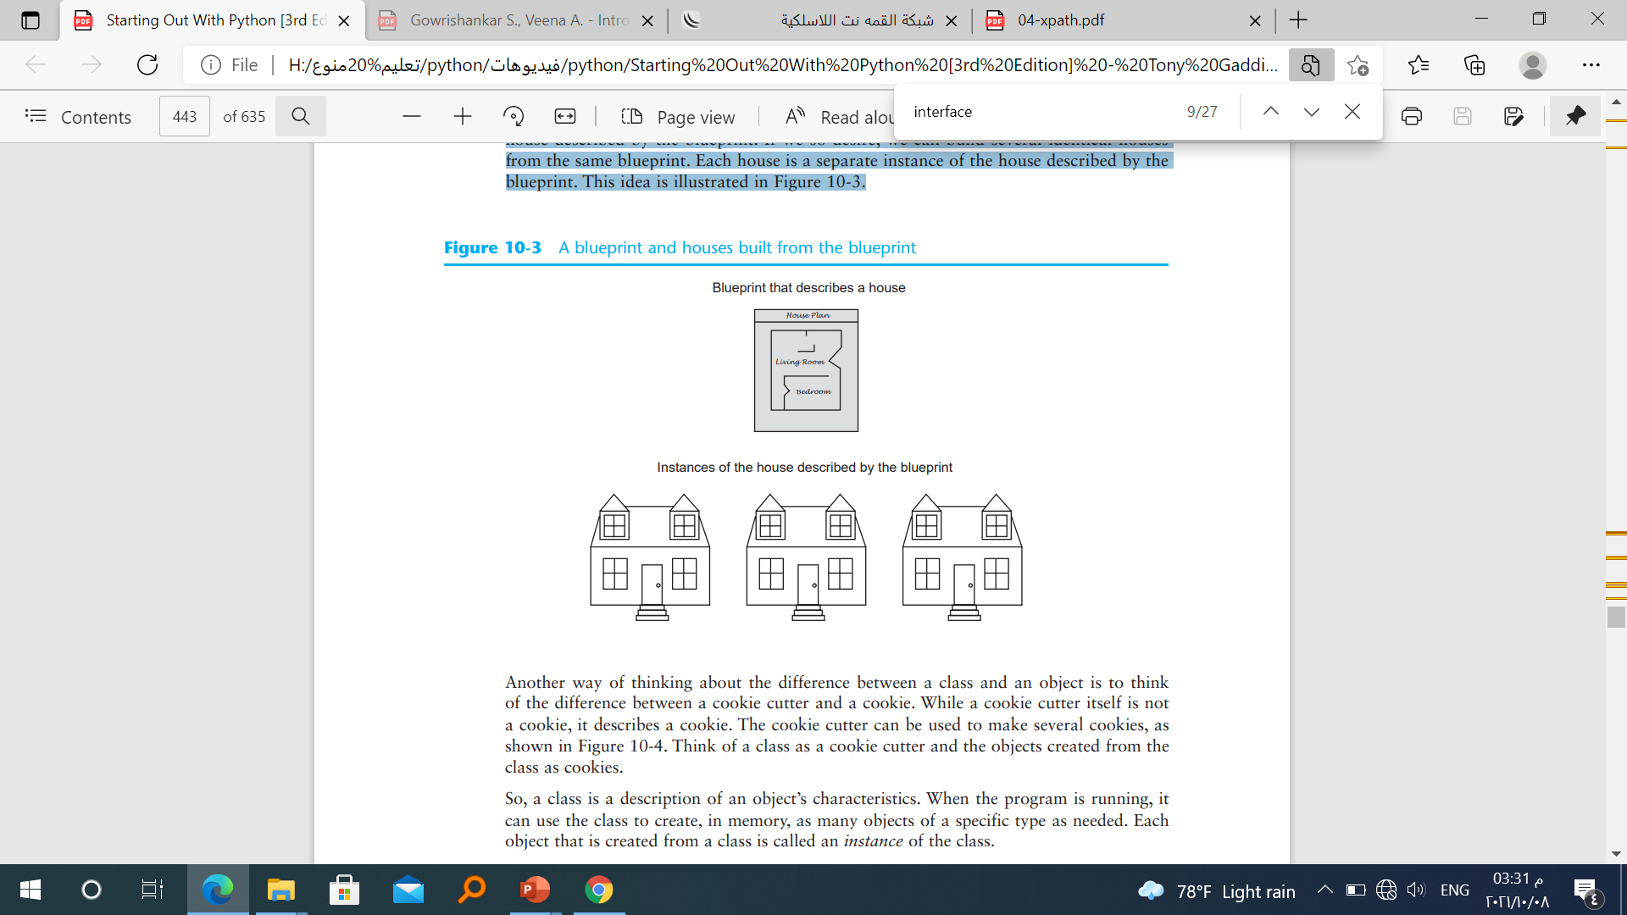
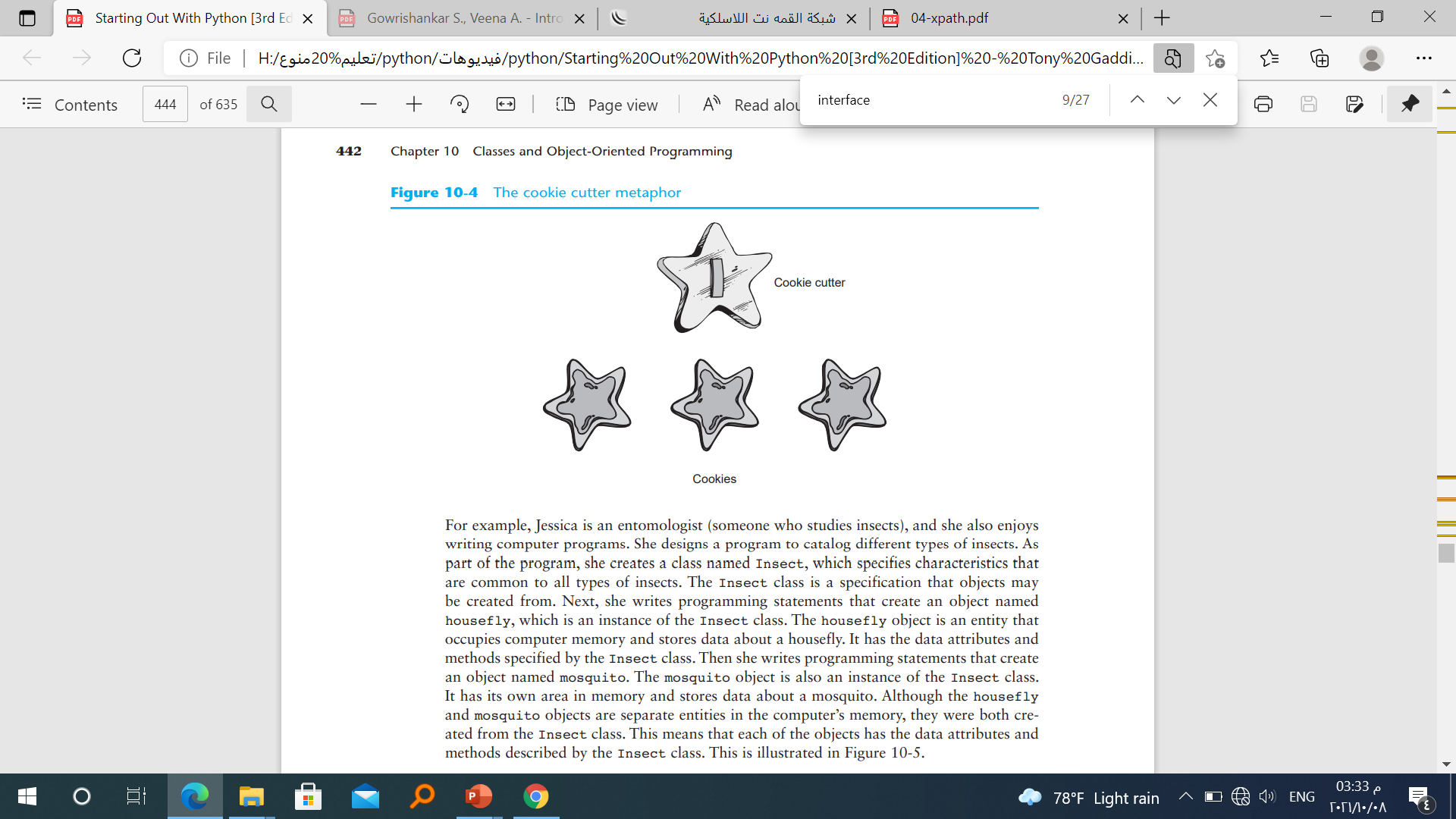
A Class

Slide 21
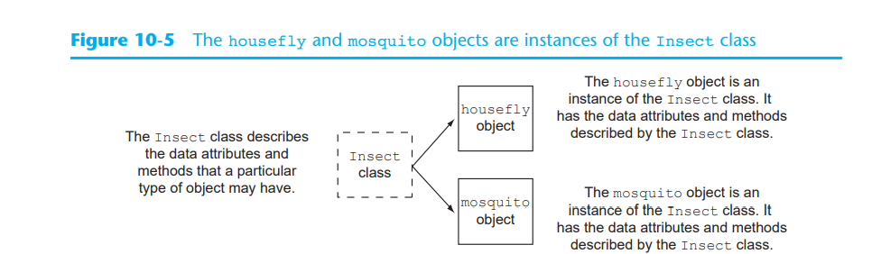
A Class

Slide 22
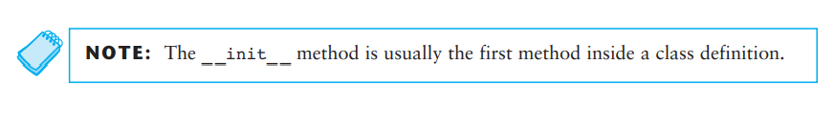
A Class Definitions
To create a class, you write a class definition.
A class definition is a set of statements that define a class’s methods and data attributes.
Let’s look at a simple example. Suppose we are writing a program to simulate the tossing of a coin. In the program we need to repeatedly toss the coin and each time determine whether it landed heads up or tails up. Taking an object-oriented approach, we will write a class named Coin that can perform the behaviors of the coin. Program 10-1 shows the class definition, which we will explain shortly. Note that this is not a complete program

Slide 23
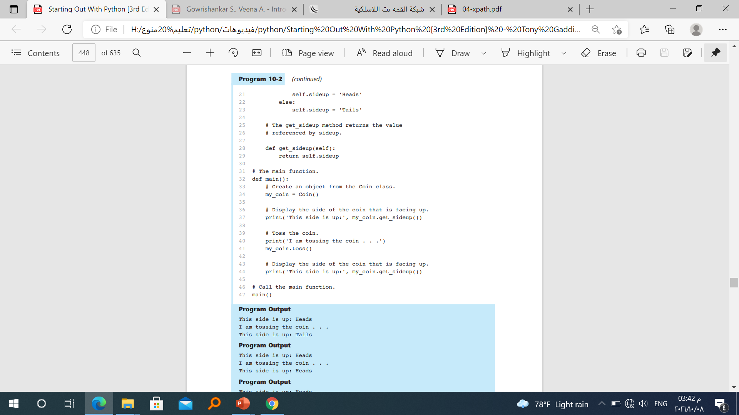
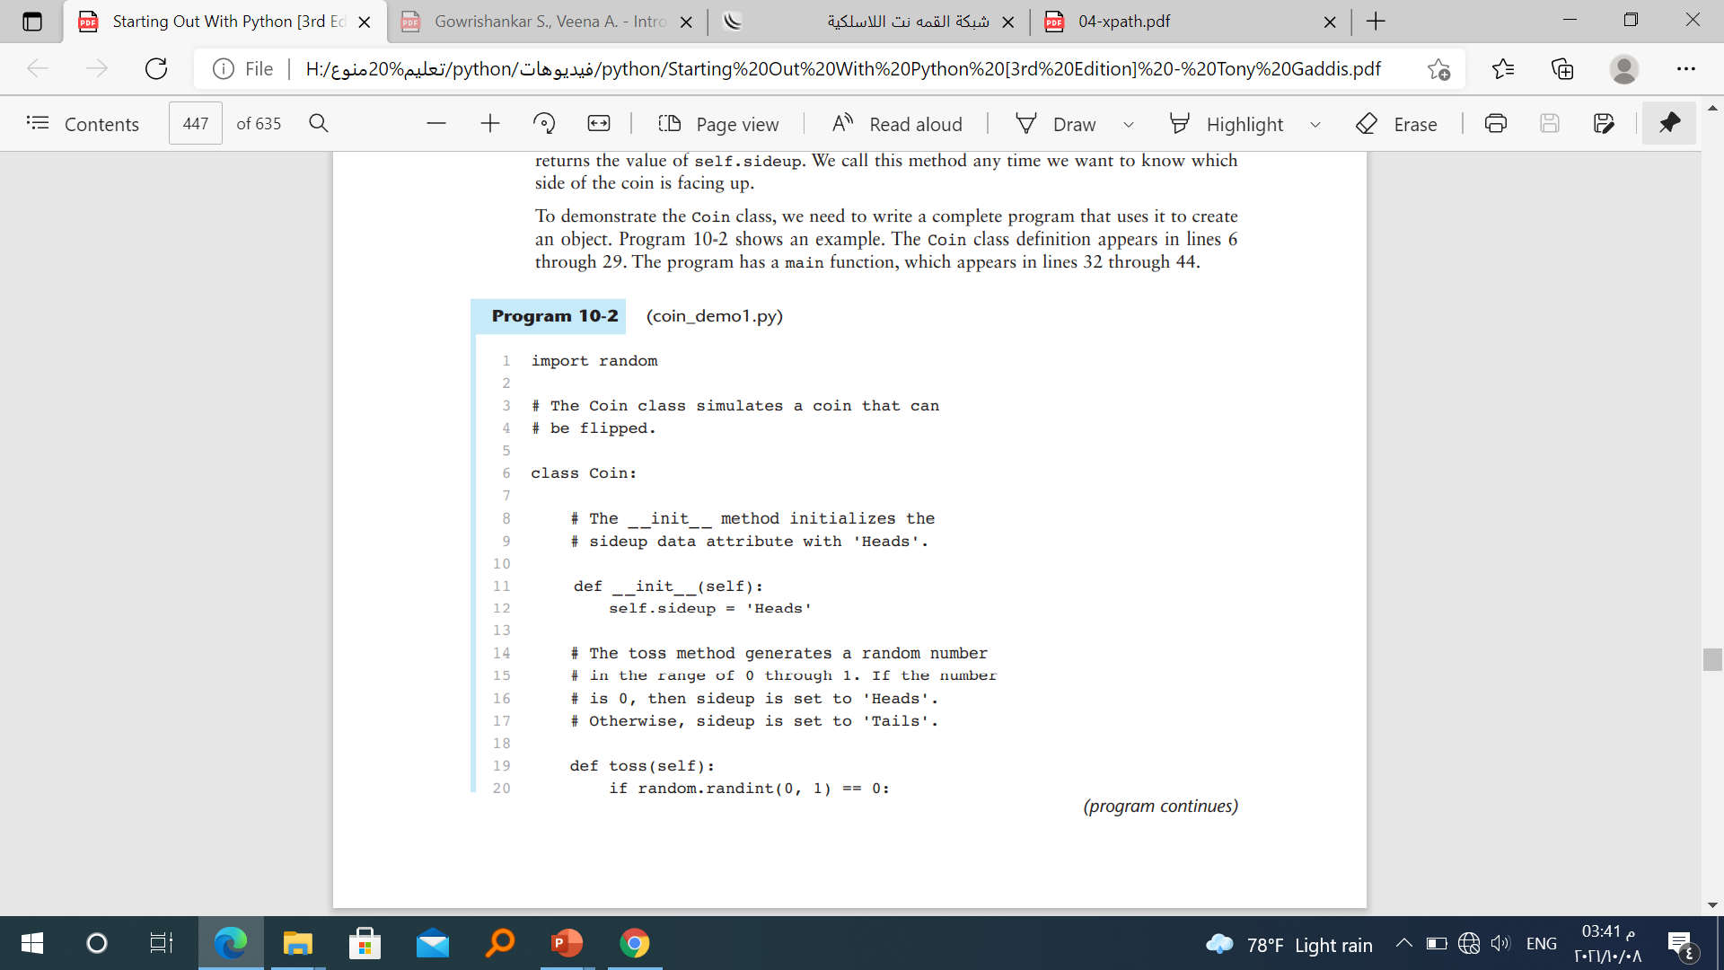

Slide 24
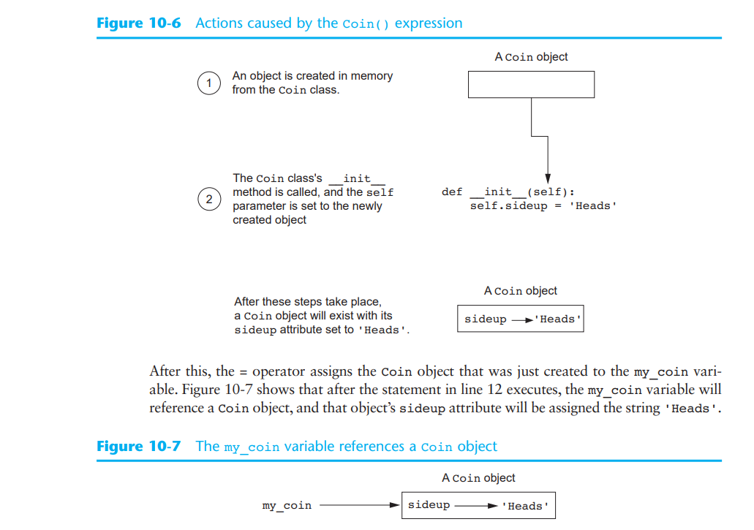
my_coin = Coin( )

Slide 25
Hiding Attributes
An object’s data attributes should be private, so that only the object’s methods can directly access them. This protects the object’s data attributes from accidental corruption. However, in the Coin class that was shown in the previous example, the sideup attribute is not private. It can be directly accessed by statements that are not in a Coin class method. Program 10-3 shows an example.

Slide 26
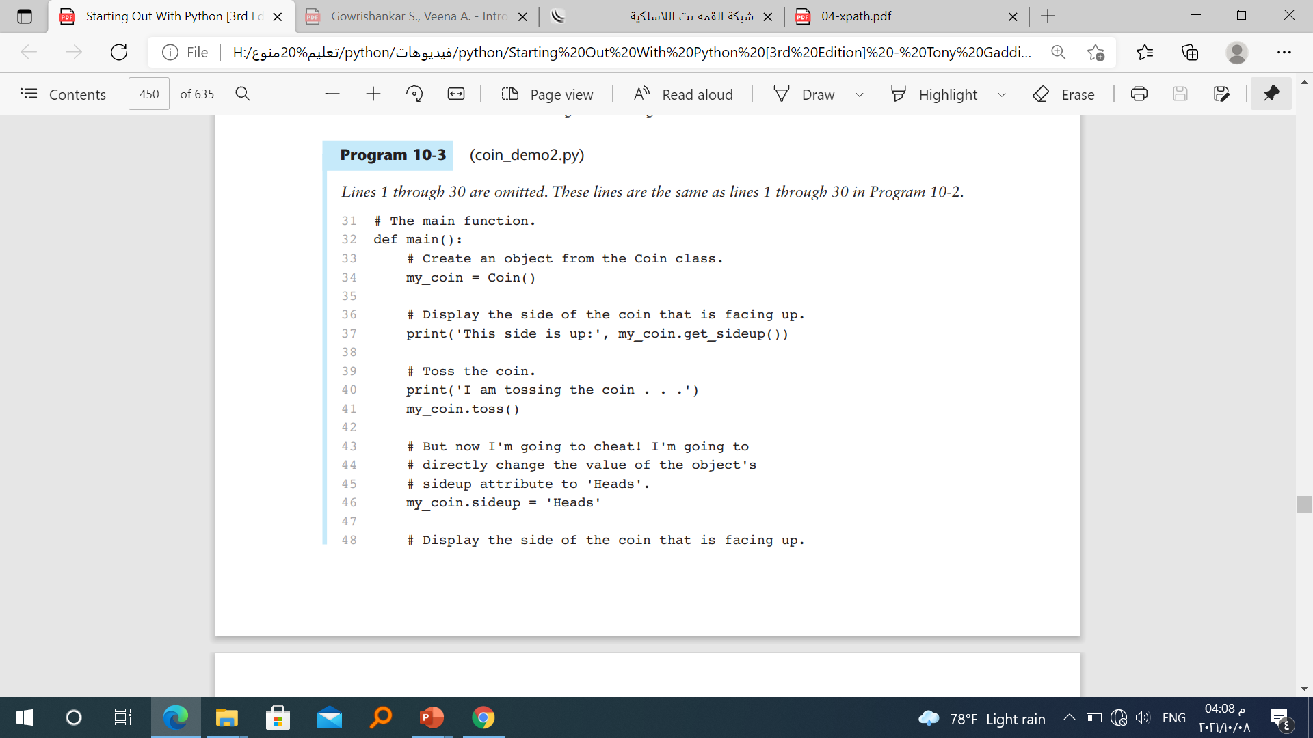
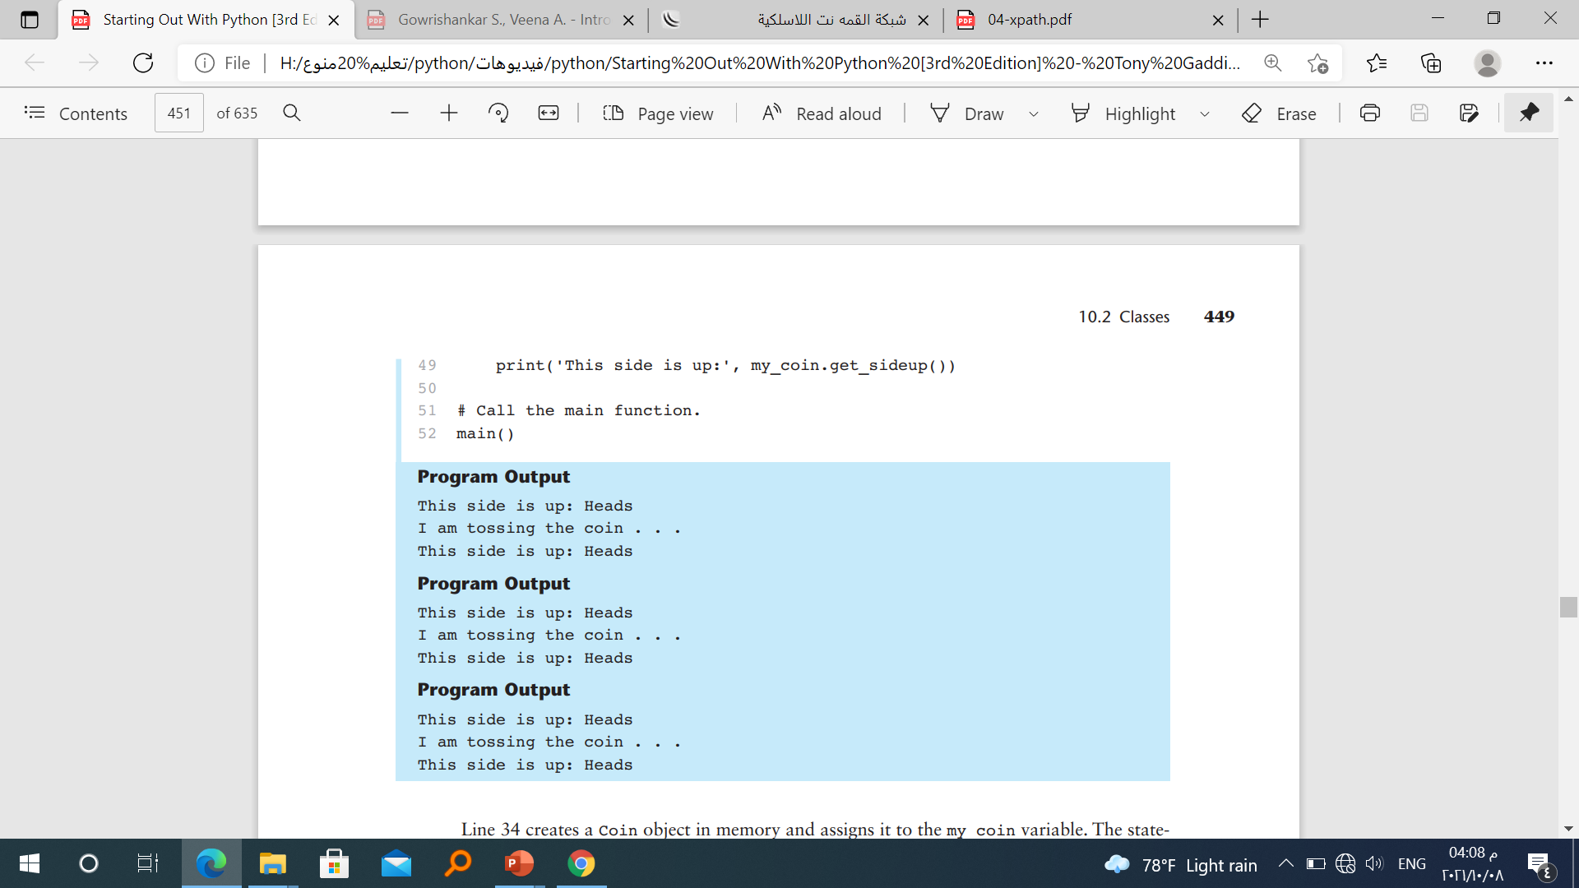

Slide 27
If we truly want to simulate a coin that is being tossed, then we don’t want code outside the class to be able to change the result of the toss method. To prevent this from happening, we need to make the sideup attribute private.
In Python you can hide an attribute by starting its name with two underscore characters. If we change the name of the sideup attribute to _ _sideup, then code outside the Coin class will not be able to access it. Program 10-4 shows a new version of the Coin class, with this change made.

Slide 28
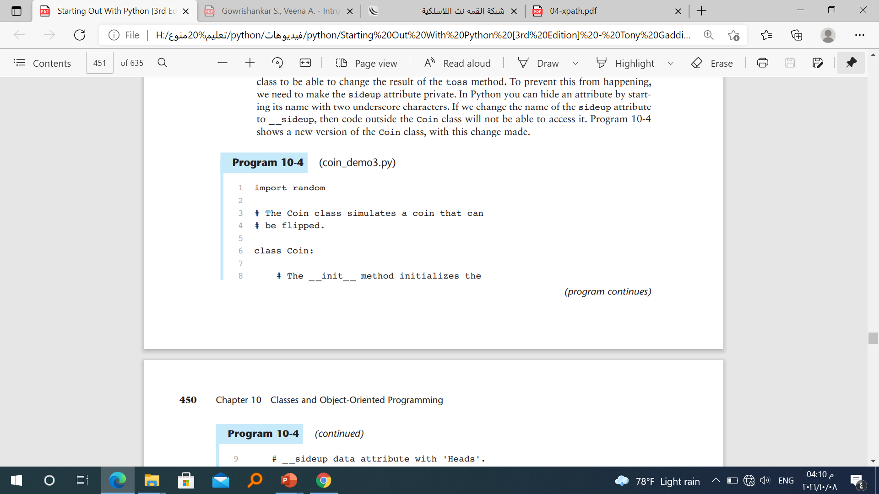
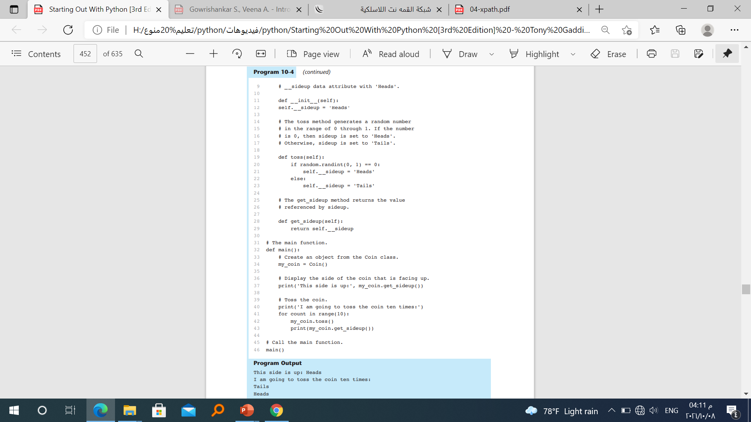

Slide 30
Storing Classes in Modules
The programs you have seen so far in this chapter have the Coin class definition in the same file as the programming statements that use the Coin class. This approach works fine with small programs that use only one or two classes. As programs use more classes, however, the need to organize those classes becomes greater.
Programmers commonly organize their class definitions by storing them in modules. Then the modules can be imported into any programs that need to use the classes they contain. For example, suppose we decide to store the Coin class in a module named coin. Program 10-5 shows the contents of the coin.py file. Then, when we need to use the Coin class in a program, we can import the coin module. This is demonstrated in Program 10-6.

Slide 31
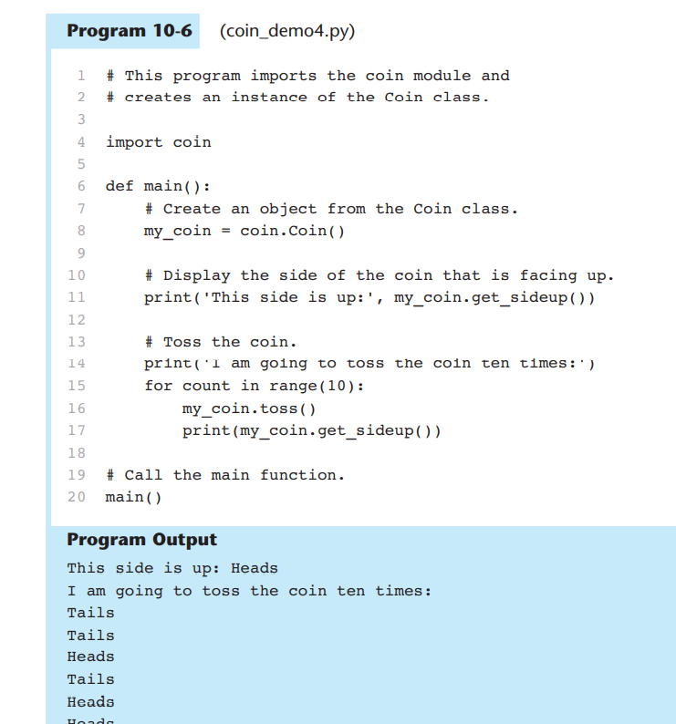

Slide 32
In object-oriented languages, they are defined together.
An object is a collection of attributes and the behaviors that operate on them.
Variables in an object are called attributes.
Procedures associated with an object are called methods.
BankAccount
Account
Account
Account
number:
balance:
deposit()
withdraw()

Slide 33
Bank Example
The “BankAccount" class describes the attributes and behaviors of bank accounts.
The “BankAccount” class defines two state variables (account number and balance) and two methods (deposit and withdraw).
class: BankAccount
number:
BankAccount
balance:
Account
Account
deposit()
Account
withdraw()
number:
balance:
deposit()
withdraw()

Slide 34
Bank Example (Cont.)
Instance #1
When the program runs there will be many instances of the account class.
Each instance will have its own account number and balance (object state)
Methods can only be invoked .
number: 054
balance: $19
Instance #2
number: 712
balance: $240
Instance #3
number: 036
balance: $941

Slide 35
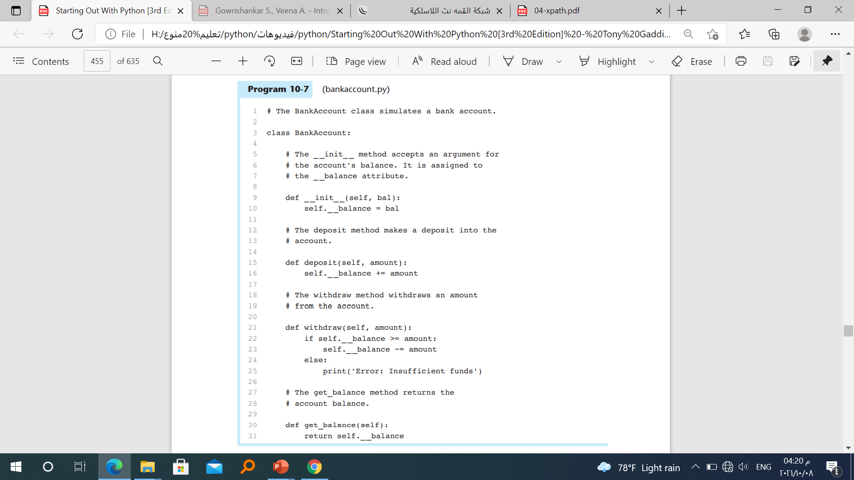
The BankAccount Class
Notice that the _ _init_ _ method has two parameter variables: self and bal. The bal parameter will accept the account’s starting balance as an argument. In line 10 the bal parameter amount is assigned to the object’s _ _balance attribute

Slide 36
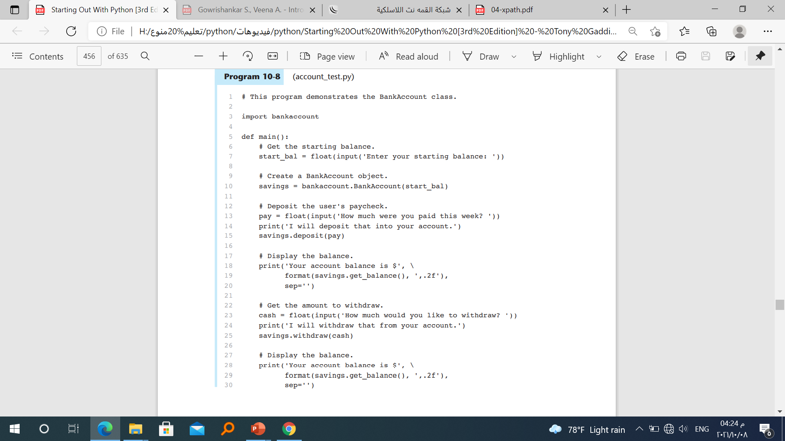
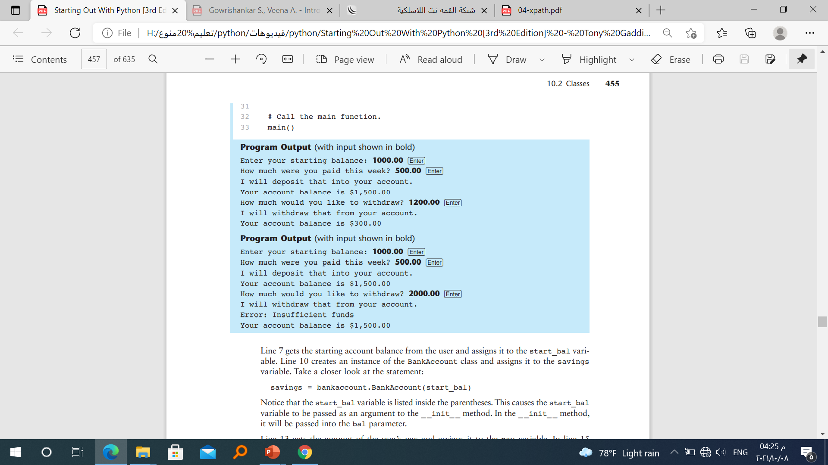

Slide 37
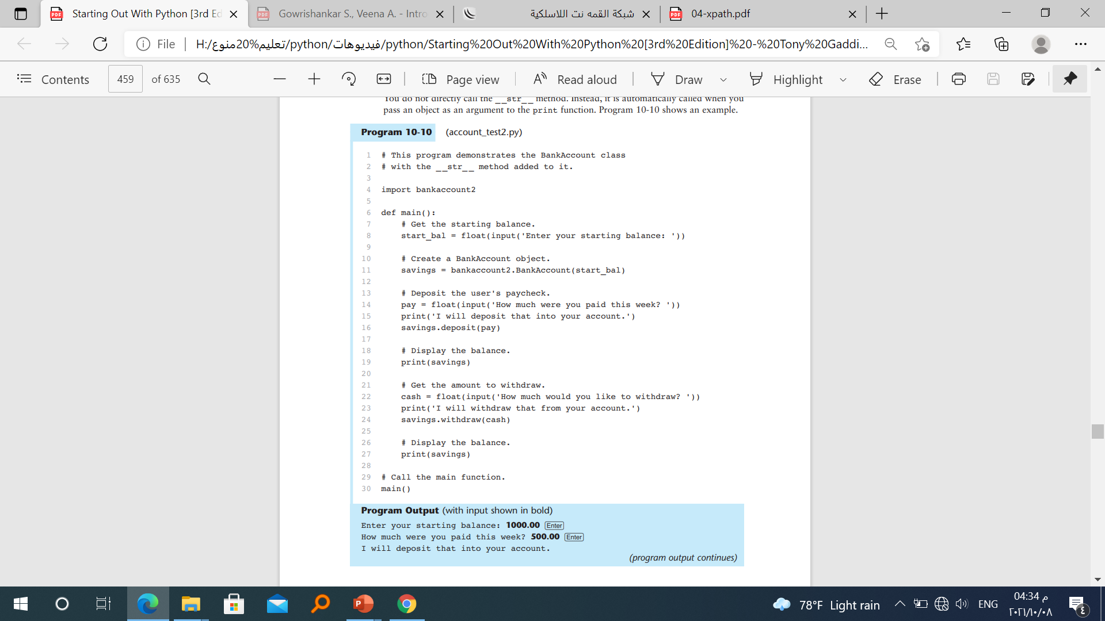
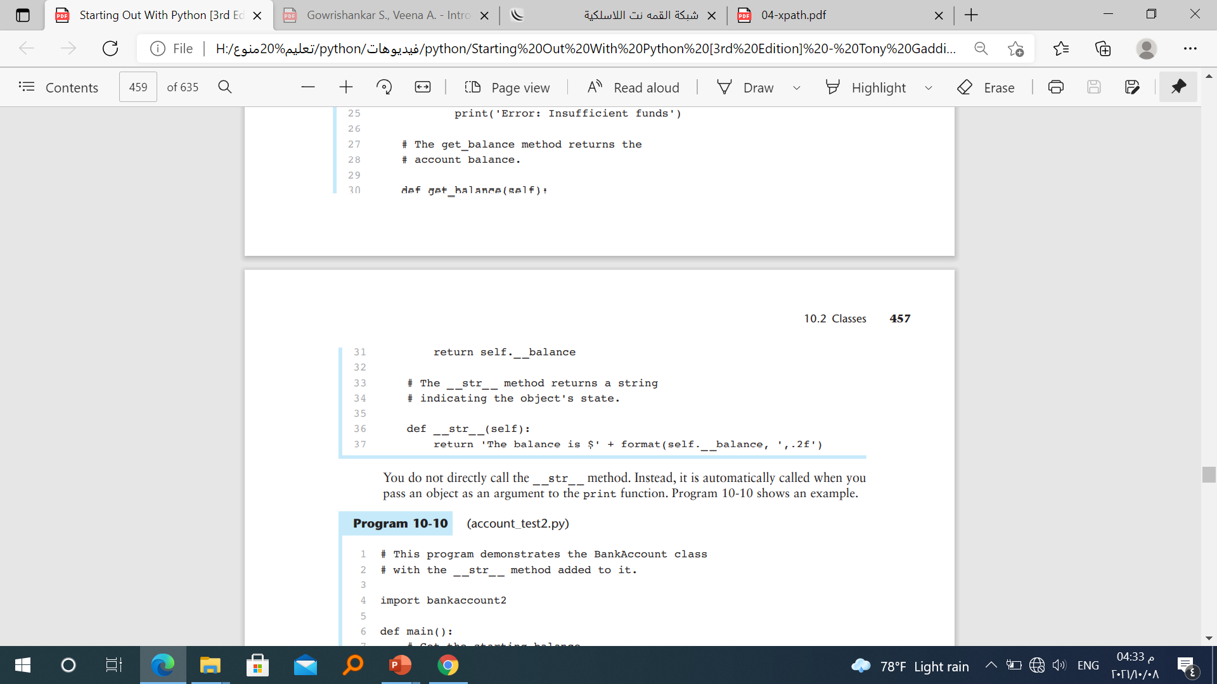
We added __str__ in Account class

Slide 38
Checkpoint
10.5 You hear someone make the following comment: “A blueprint is a design for a house. A carpenter can use the blueprint to build the house. If the carpenter wishes, he or she can build several identical houses from the same blueprint.” Think of this as a metaphor for classes and objects. Does the blueprint represent a class, or does it represent an object?
10.6 In this chapter, we use the metaphor of a cookie cutter and cookies that are made from the cookie cutter to describe classes and objects. In this metaphor, are objects the cookie cutter, or the cookies?
10.7 What is the purpose of the _ _init_ _ method? When does it execute?
10.8 What is the purpose of the self parameter in a method?
10.9 In a Python class, how do you hide an attribute from code outside the class?
10.10 What is the purpose of the _ _str_ _ method?
10.11 How do you call the _ _str_ _ method?

Slide 39
Concept: Each instance of a class has its own set of data attributes.
When a method uses the self parameter to create an attribute, the attribute belongs to the specific object that self references. We call these attributes instance attributes because they belong to a specific instance of the class.

Slide 40
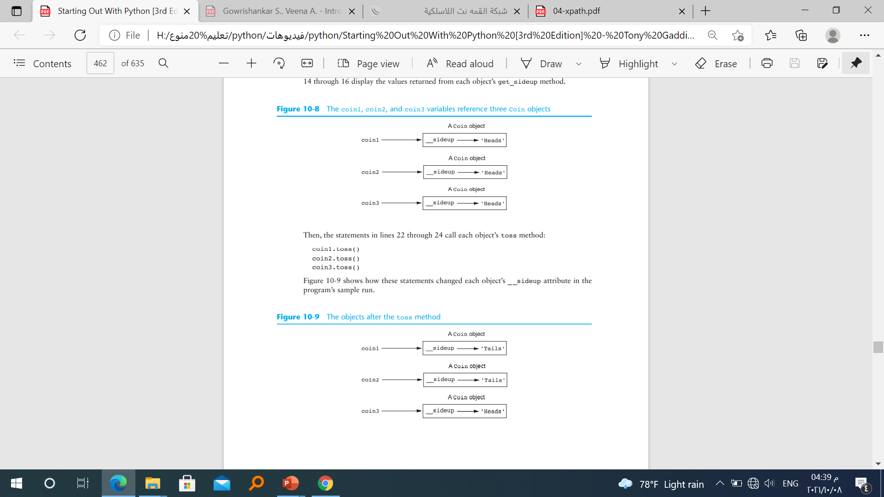

Slide 41
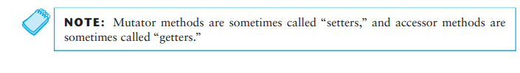
Accessor and Mutator Methods
A method that returns a value from a class’s attribute but does not change it is known as an accessor method. Accessor methods provide a safe way for code outside the class to retrieve the values of attributes, without exposing the attributes in a way that they could be changed by the code outside the method
A method that stores a value in a data attribute or changes the value of a data attribute in some other way is known as a mutator method. Mutator methods can control the way that a class’s data attributes are modified. When code outside the class needs to change the value of an object’s data attribute, it typically calls a mutator and passes the new value as an argument. If necessary, the mutator can validate the value before it assigns it to the data attribute.

Slide 42
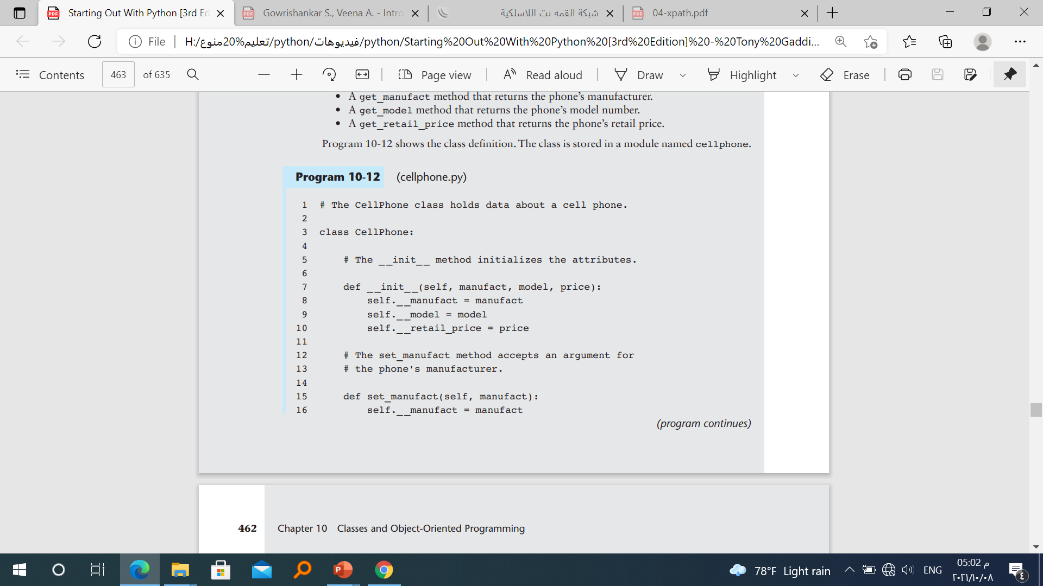
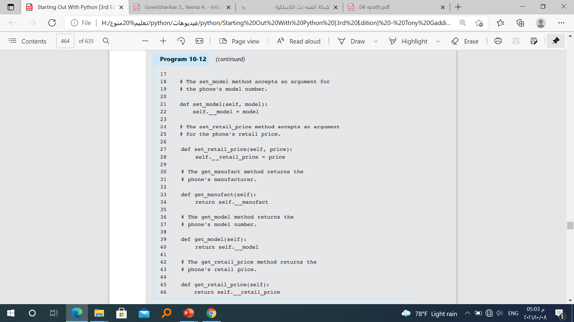

Slide 43
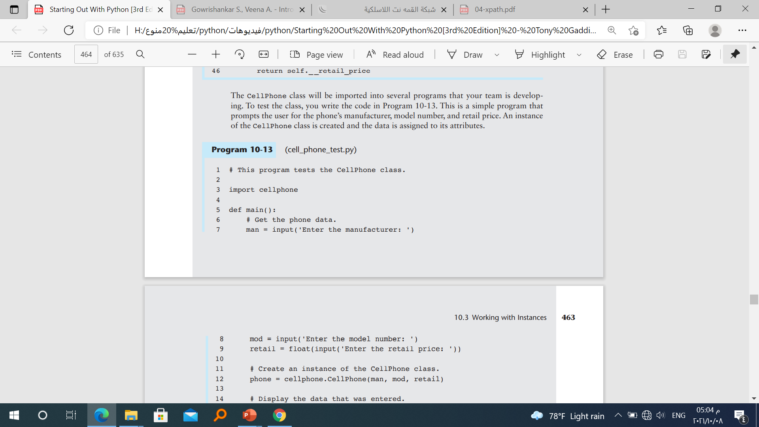
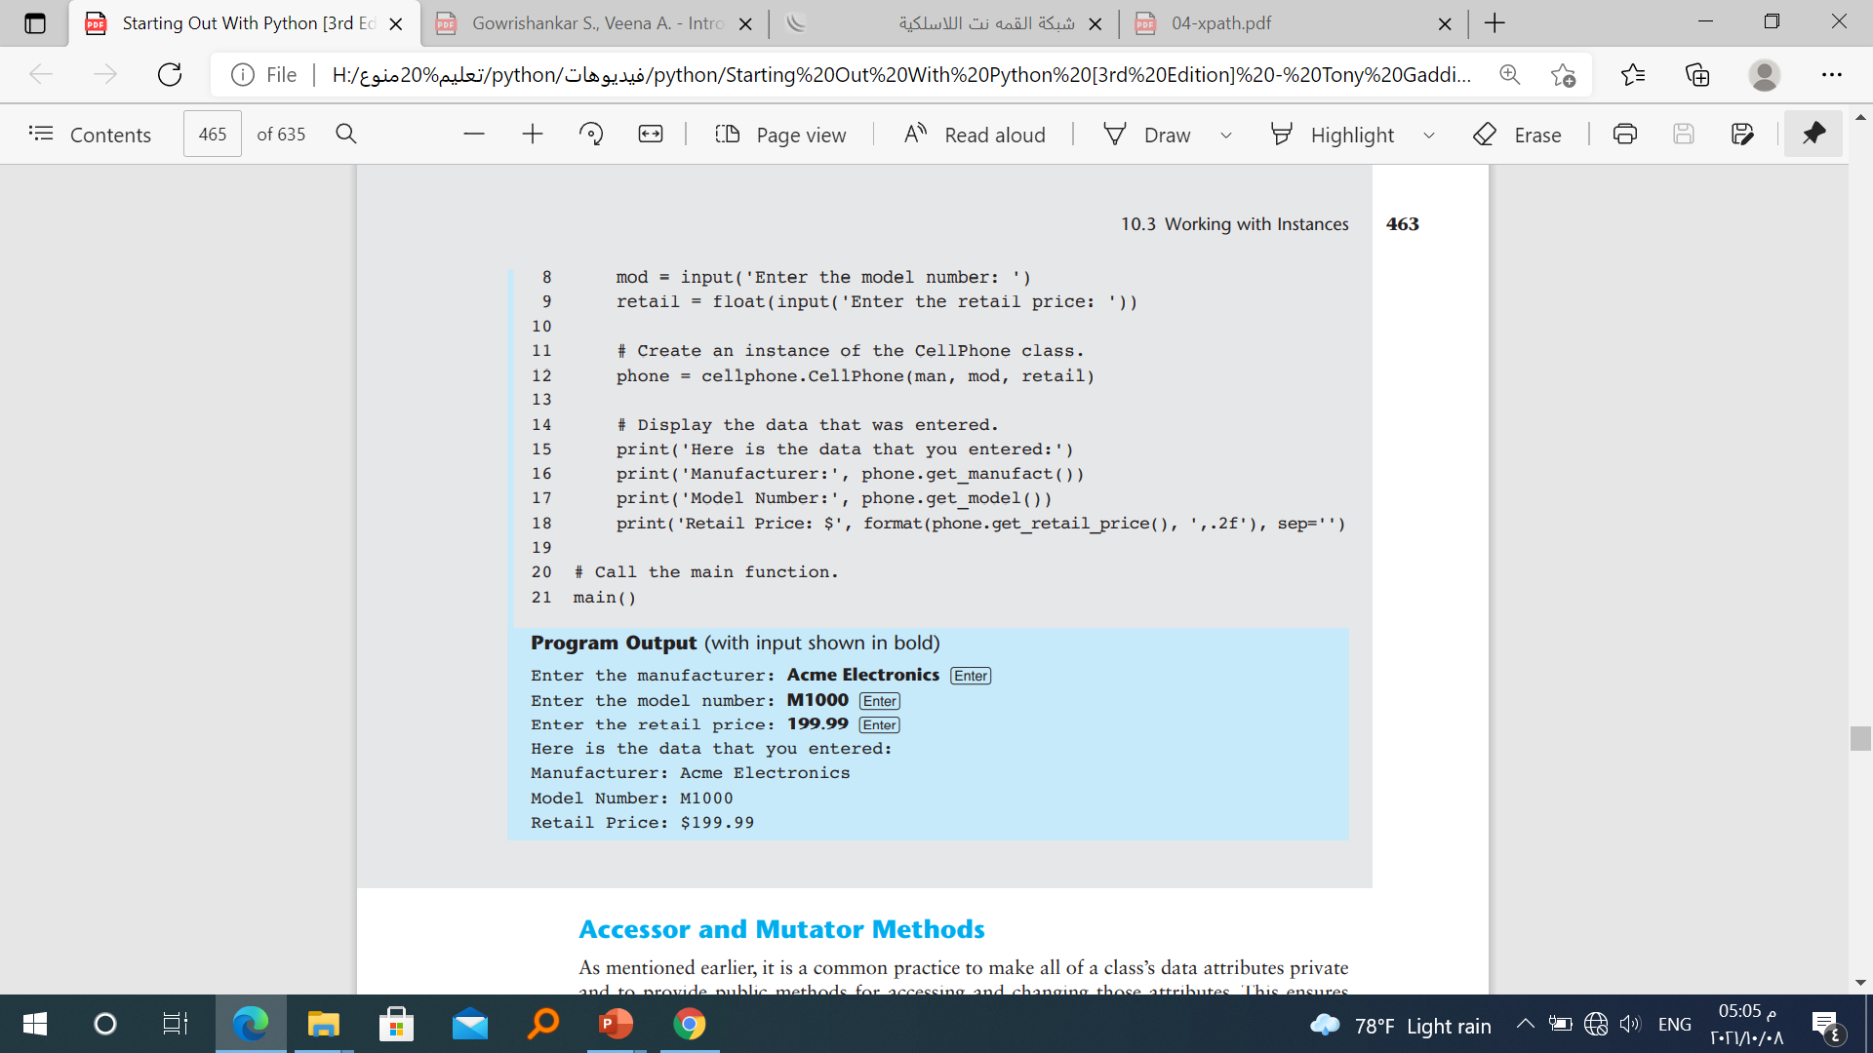

Slide 44
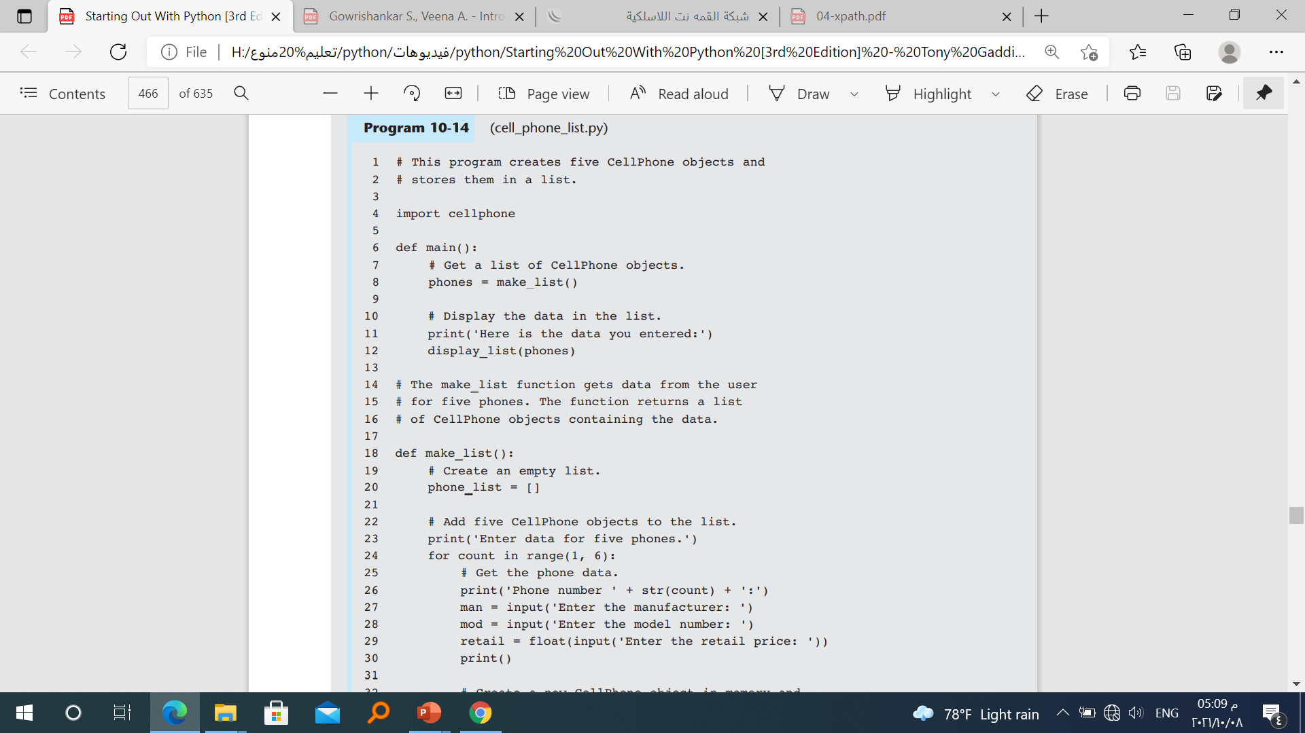
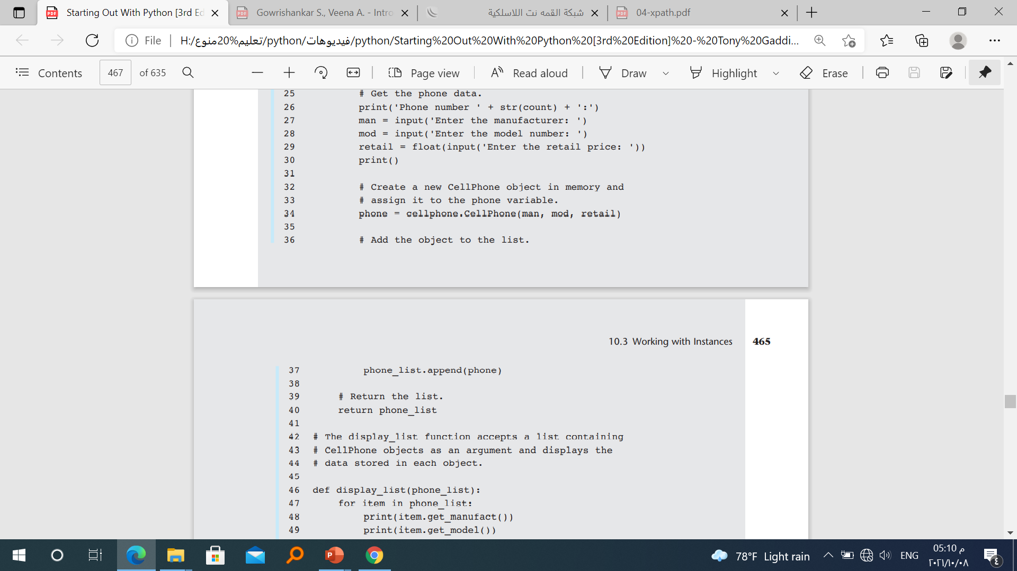
Storing Objects in a List

Slide 45
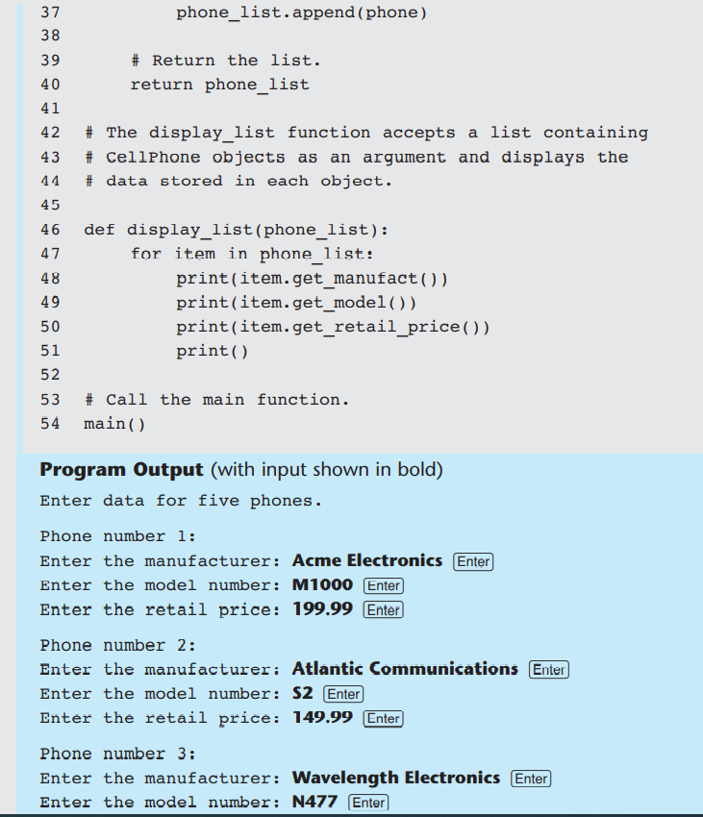

Slide 46
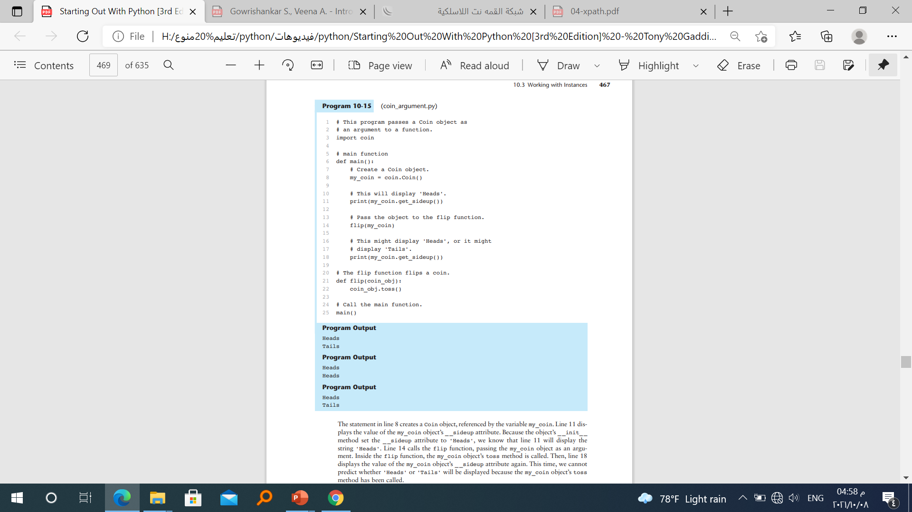
Passing Objects as Arguments

Slide 47
Techniques for Designing Classes
The Unified Modeling Language
When designing a class, it is often helpful to draw a UML diagram. UML stands for Unified Modeling Language. It provides a set of standard diagrams for graphically depicting object oriented systems. Figure 10-10 shows the general layout of a UML diagram for a class. Notice that the diagram is a box that is divided into three sections. The top section is where you write the name of the class. The middle section holds a list of the class’s data attributes. The bottom section holds a list of the class’s methods.

Slide 48
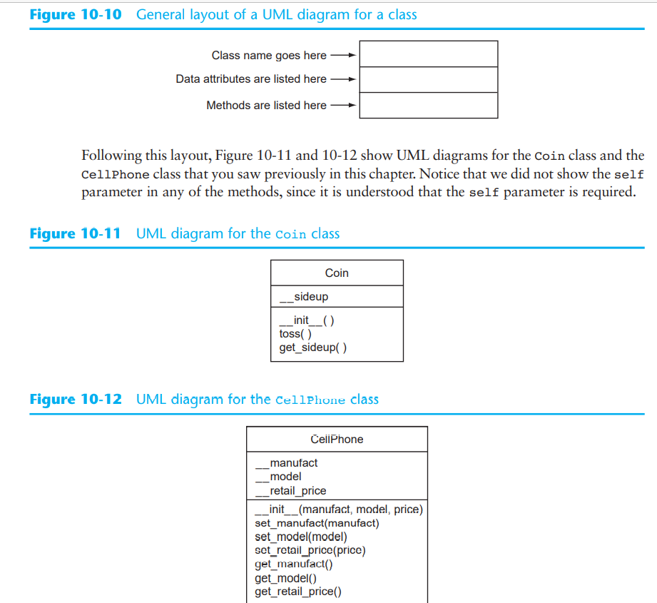

Slide 49
Finding the Classes in a Problem
When developing an object-oriented program, one of your first tasks is to identify the classes that you will need to create. Typically, your goal is to identify the different types of real-world objects that are present in the problem and then create classes for those types of objects within your application.
Over the years, software professionals have developed numerous techniques for finding the classes in a given problem. One simple and popular technique involves the following steps.
1. Get a written description of the problem domain.
2. Identify all the nouns (including pronouns and noun phrases) in the description. Each of these is a potential class.
3. Refine the list to include only the classes that are relevant to the problem
Some of the nouns might represent objects, not classes.
Some of the nouns might represent simple values that can be assigned to a variable and do not require a class.

Slide 50
Identifying a Class’s Responsibilities
Once the classes have been identified, the next task is to identify each class’s responsibilities.
A class’s responsibilities are
• the things that the class is responsible for knowing
• the actions that the class is responsible for doing

Slide 51
The Customer Class (EX.)
In the context of our problem domain, what must the Customer class know? The description directly mentions the following items, which are all data attributes of a customer:
• the customer’s name
• the customer’s address
• the customer’s telephone number
Now let’s identify the class’s methods. In the context of our problem domain, what must
the Customer class do? The only obvious actions are:
• initialize an object of the Customer class
• set and return the customer’s name
• set and return the customer’s address
• set and return the customer’s telephone number

Slide 52
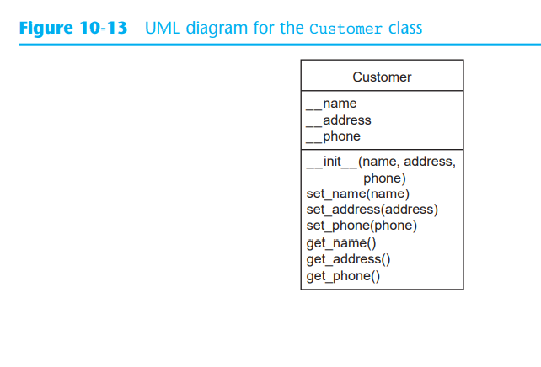

Slide 53
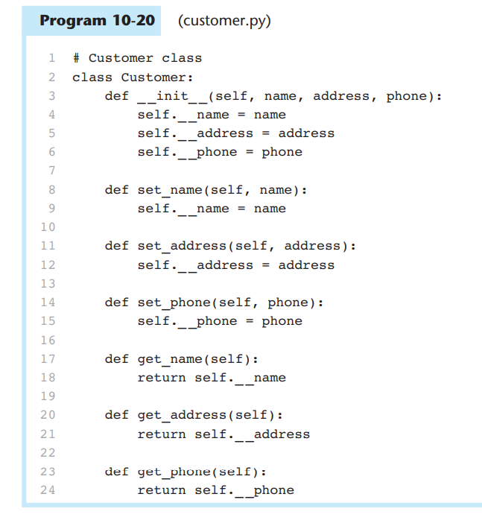

Slide 54
Checkpoint
10.15 The typical UML diagram for a class has three sections. What appears in these
three sections?
10.16 What is a problem domain?
10.17 When designing an object-oriented application, who should write a description of the problem domain?
10.18 How do you identify the potential classes in a problem domain description?
10.19 What are a class’s responsibilities?
10.20 What two questions should you ask to determine a class’s responsibilities?
10.21 Will all of a class’s actions always be directly mentioned in the problem domain
description?

Slide 55
Concept: Inheritance allows a new class to extend an existing class. The new class inherits the members of the class it extends
Generalization and Specialization In the real world, you can find many objects that are specialized versions of other more general objects. For example, the term “insect” describes a general type of creature with various characteristics. Because grasshoppers and bumblebees are insects, they have all the general characteristics of an insect. In addition, they have special characteristics of their own

Slide 56
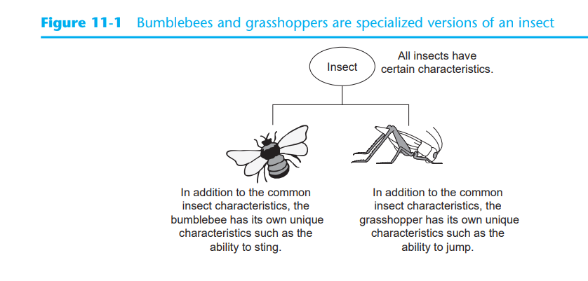

Slide 57
Inheritance and the “Is a” Relationship
When an “is a” relationship exists between objects, it means that the specialized object has all of the characteristics of the general object, plus additional characteristics that make it special. In object-oriented programming, inheritance is used to create an “is a” relationship among classes. This allows you to extend the capabilities of a class by creating another class that is a specialized version of it.

Slide 58
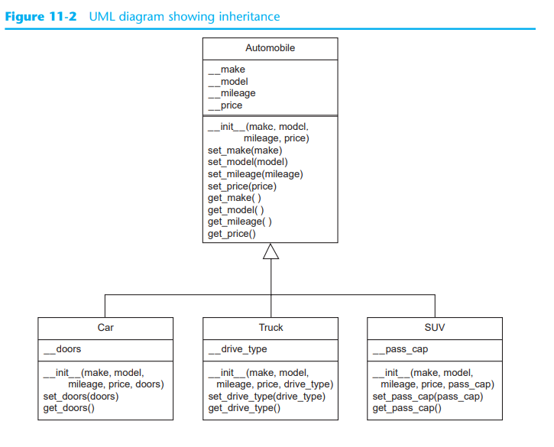

Slide 59
Example
A Car class with data attributes for the make, year model, mileage, price, and the number of doors.
A Truck class with data attributes for the make, year model, mileage, price, and the drive type.
An SUV class with data attributes for the make, year model, mileage, price, and the passenger capacity

Slide 60
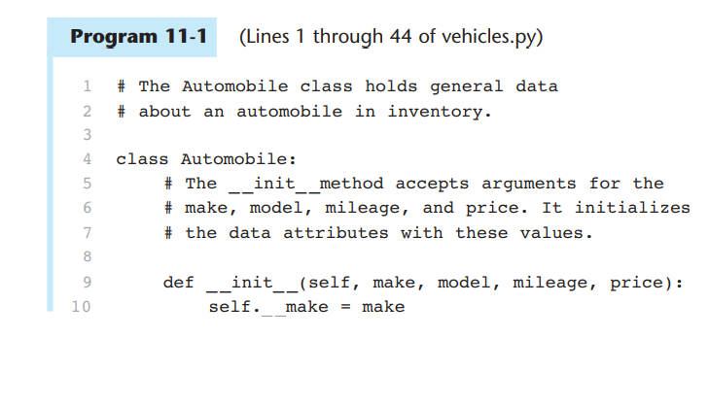

Slide 61
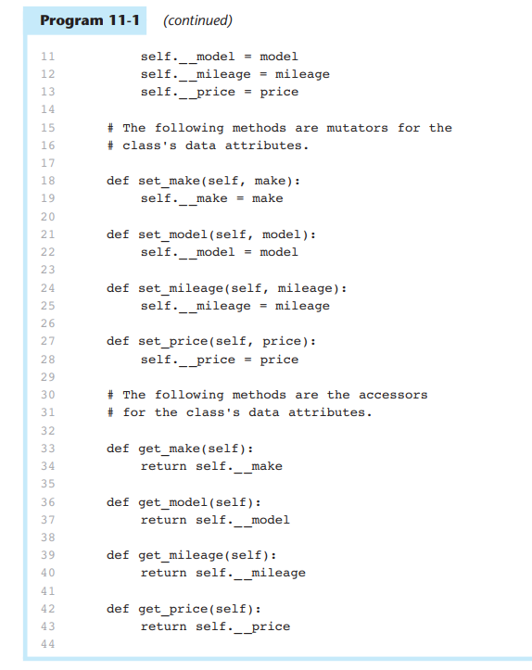

Slide 62
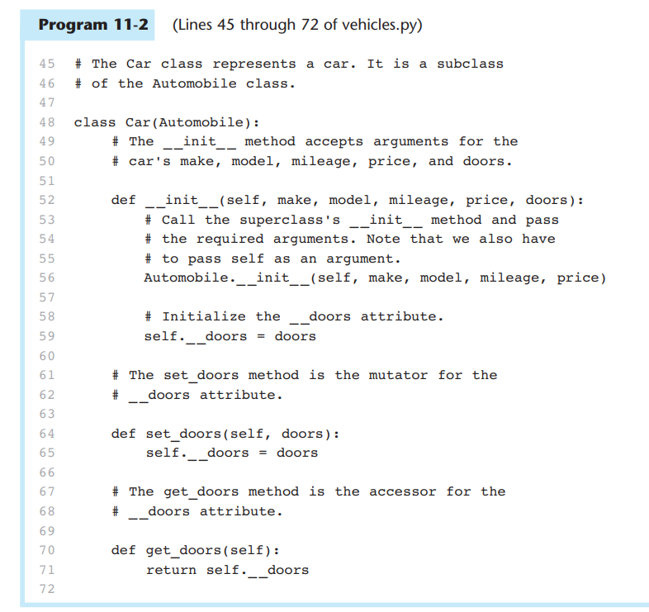

Slide 63
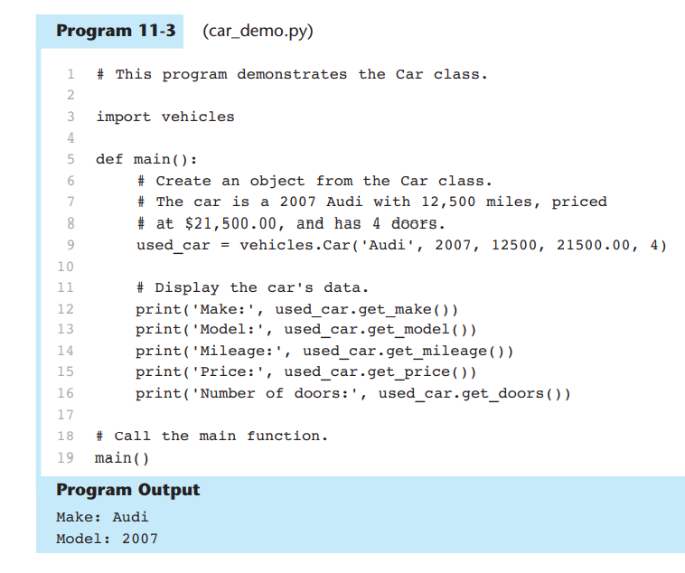

Slide 64
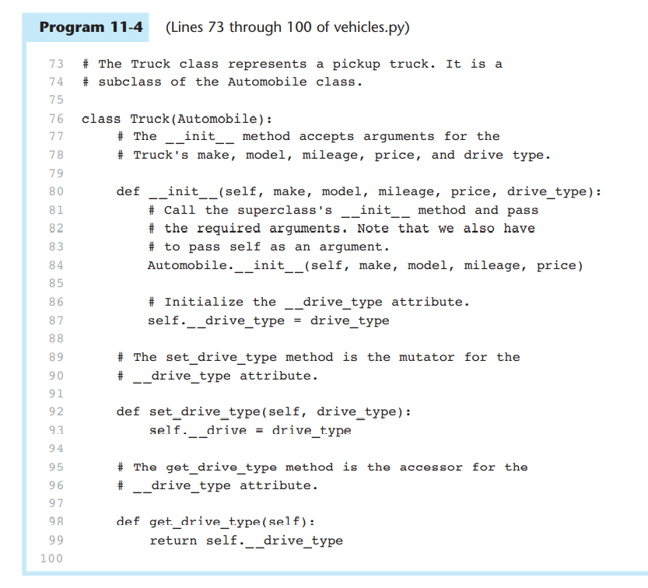

Slide 65
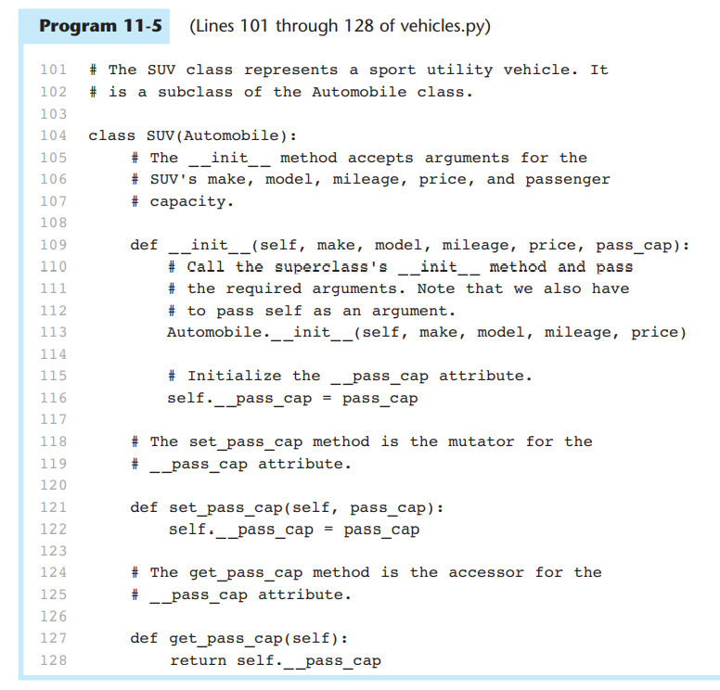

Slide 66
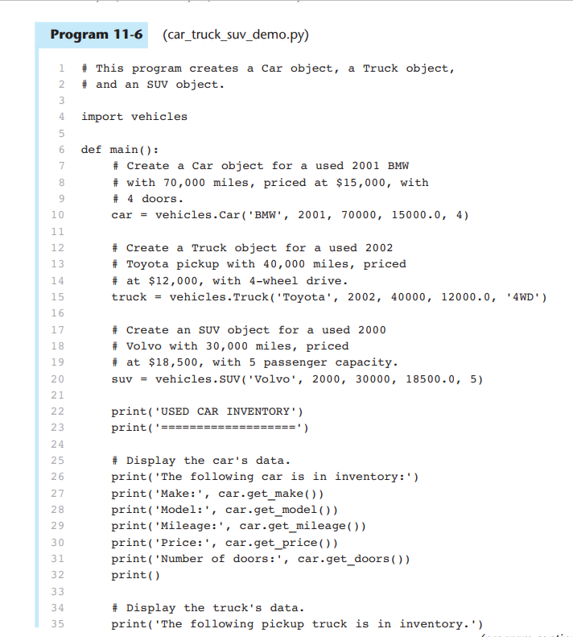

Slide 67
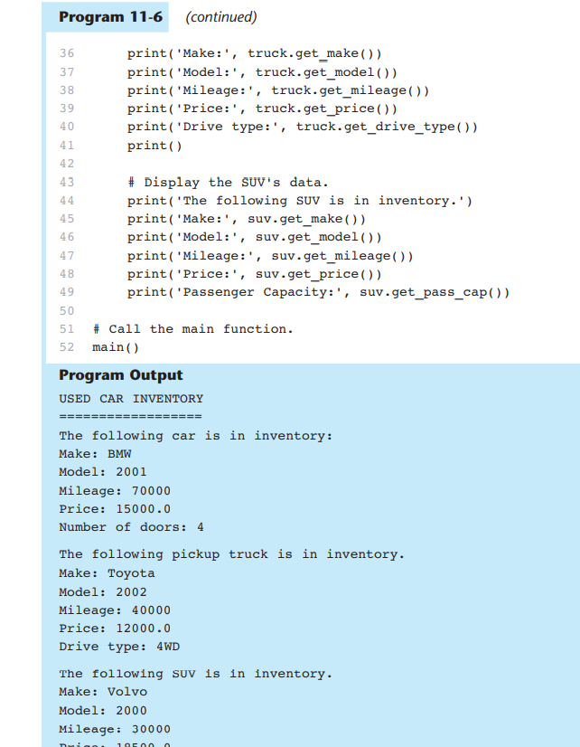

Slide 68
Checkpoint
11.1 In this section we discussed super classes and subclasses. Which is the general class, and which is the specialized class?
11.2 What does it mean to say there is an “is a” relationship between two objects?
11.3 What does a subclass inherit from its superclass?
11.4 Look at the following code, which is the first line of a class definition. What is the name of the superclass? What is the name of the subclass?
class Canary(Bird)

Slide 69
Concept: Polymorphism allows subclasses to have methods with the same names as methods in their superclasses. It gives the ability for a program to call the correct method depending on the type of object that is used to call it.
The term polymorphism refers to an object’s ability to take different forms. It is a powerful feature of object-oriented programming. In this section, we will look at two essential
ingredients of polymorphic behavior:
1. The ability to define a method in a superclass, and then define a method with the same name in a subclass. When a subclass method has the same name as a superclass method, it is often said that the subclass method overrides the superclass method.
2.The ability to call the correct version of an overridden method, depending on the type of object that is used to call it. If a subclass object is used to call an overridden method, then the subclass’s version of the method is the one that will execute. If a superclass object is used to call an overridden method, then the superclass’s version of the method is the one that will execute.

Slide 70
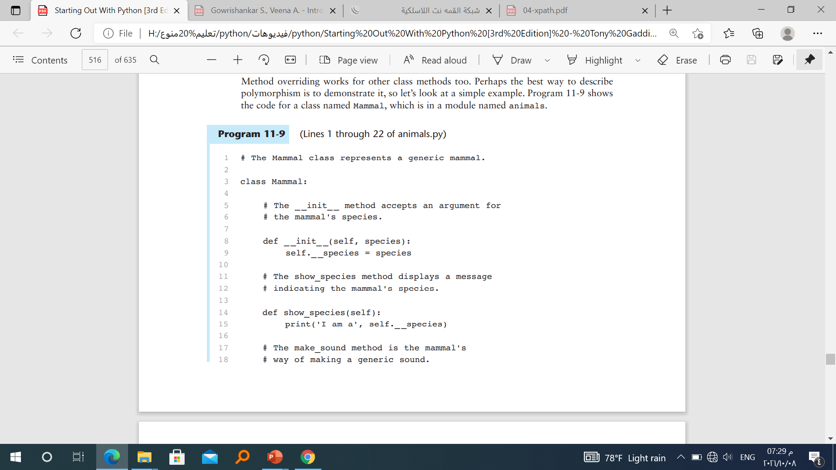
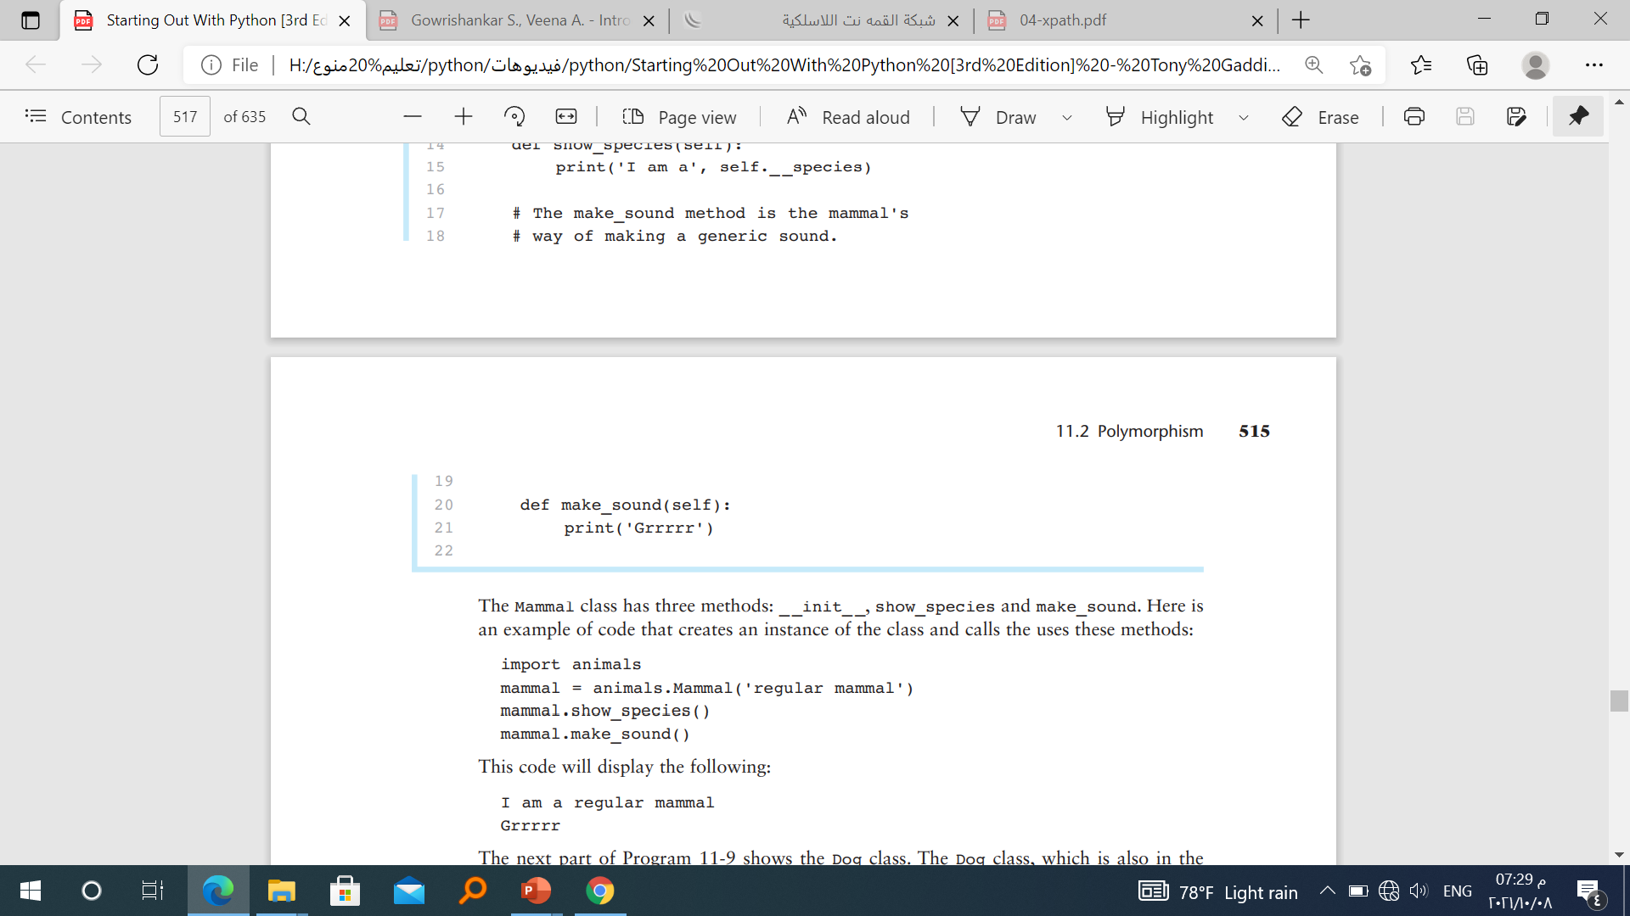

Slide 71
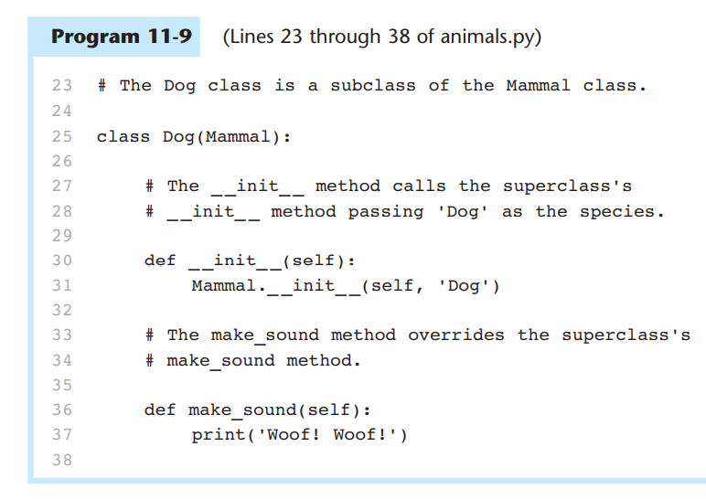

Slide 72
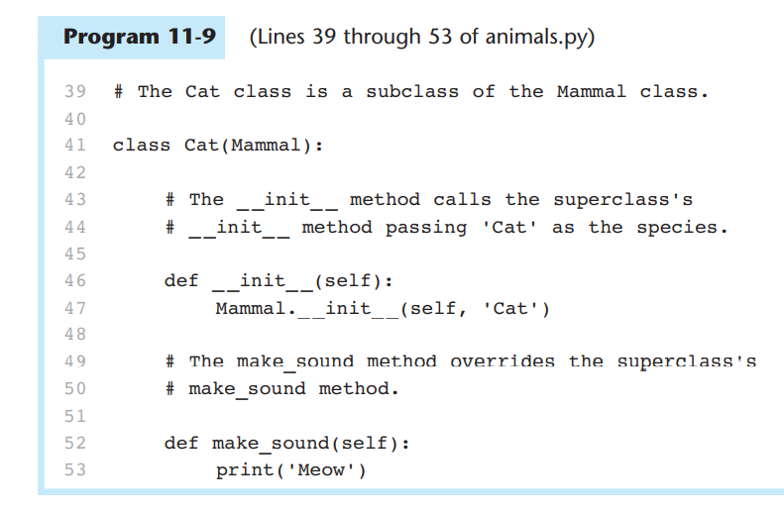

Slide 73
The isinstance Function
Polymorphism gives us a great deal of flexibility when designing programs. For example,
look at the following function:
def show_mammal_info(creature):
creature.show_species()
creature.make_sound()
We can pass any object as an argument to this function, and as long as it has a show_species method and a make_sound method, the function will call those methods. In essence, we can pass any object that “is a” Mammal (or a subclass of Mammal) to the function. Program 11-10 demonstrates

Slide 74
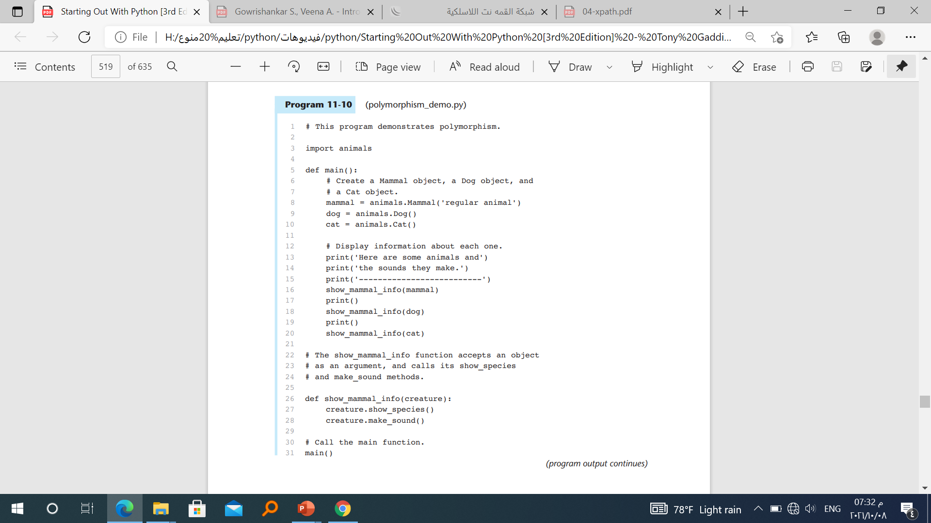
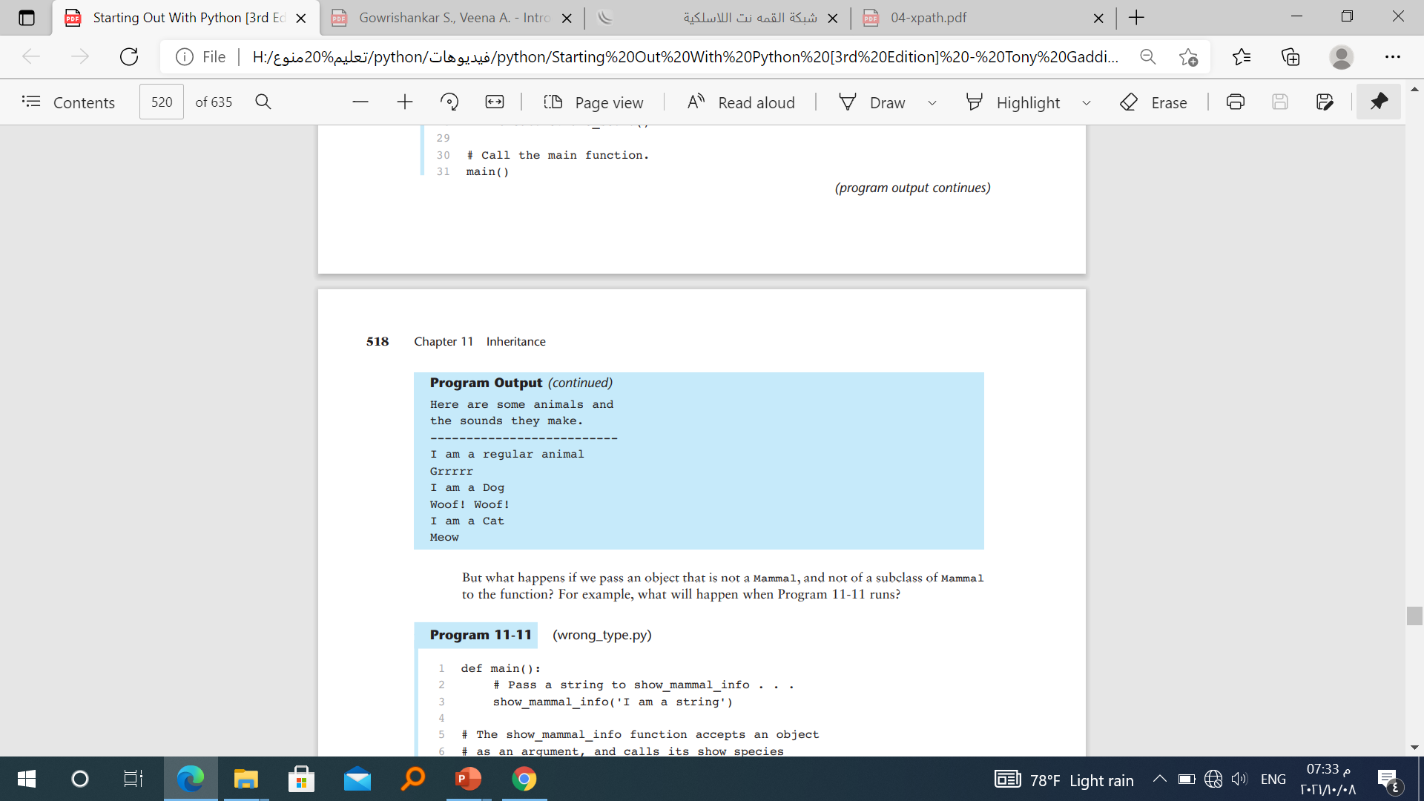

Slide 75


Slide 76
Conclusion
To avoid spaghetti code, we use object oriented programming which is built on four pillars. These pillars are
Encapsulation.
Abstraction.
Inheritance.
Polymorphism.
Encapsulation - This is a grouping methods and properties that perform the same function into object.

Slide 77

Abstraction — A good example is a DVD player or a remote control. It has complex wiring on the inside and few buttons on the outside. All complexity is hidden from the user and only few buttons are made available to the user.

Slide 78

Inheritance — Lets you remove redundancy in code. This is the situation where by objects can inherit from properties and attributes from other objects.

Slide 79

Polymorphism — Lets you avoid and get round long if/else cases.

